Slide 1
Scrum-AGile
Assessing organizational readiness
10//13/2025
Alec Reach
CS250

Slide 2
Roles and TEaM ORGANIZATION
When adopting a Scrum-agile framework, team structure
changes significantly from traditional models.
Each Member assumes a clearly defined role,
ensuring accountability and collaboration throughout every sprint.

Slide 3

Team Roles

Slide 4
The product Owner
The product owner serves as the link between business stakeholders and the development team. They focus on maximizing the value produced by the team’s efforts through effective backlog management.

Slide 5
The product Owner
VALUES
Clearly communicates and prioritize backlog items.
Ensures the development team fully understands project goals and user needs.
Maintain visibility and transparency across all backlog elements.
Continuously refines the backlog to align with evolving objectives and ensures readiness for upcoming sprints.

Slide 6
The SCRUM MASTER
The scrum master facilitates scrum implementation and ensures the process functions effectively across the organization.

Slide 7
The SCRUM MASTER
VALUES
Promote adherence to scrum principles that are outlined in the Scrum Guide
Serve as a leader, helping remove barriers and enabling progress
Coaches the team toward self-management and continuous improvement
Guide stakeholders and leaders in understanding agile values
Ensure scrum events occur consistently and remain focused and productive
Encourage collaboration between the product owner, team members, and external stakeholders

Slide 8
The developers
The developers are responsible for delivering a functional product increment during each sprint. Their role centers on ownership, collaboration, and adaptability.

Slide 9
The developers
VALUES
Plan sprints and manage the sprint backlog collaboratively
Uphold quality by following the definition of done
Adjust strategies daily to meet the sprint goal
Support one another through accountability and cross-functional teamwork
Operate without sub-teams, ensuring self-organization and efficiency

Slide 10
Process change: a shift to agile sdlc
Transitioning from the traditional Software Development Life Cycle to an agile model introduces iterative progress and continuous feedback.

Slide 11
Process change
Traditional Vs. Agile
Traditional:
Agile:
Development begins only after the requirements and design are finalized
Often can delay any type of flexibility
Requirements evolve progressively through user stories
Each sprint produces a working product increment
Testing, developing, and user feedback occur throughout the cycle rather than at the end
The workflow emphasizes adaptability through sprints
- Planning
- daily scrum meetings
- review and retrospective

Slide 12
Phases of the software development
Requirements gathering, software design,
Software development, test and integration,
Deployment, operationalization and maintenance

Slide 13
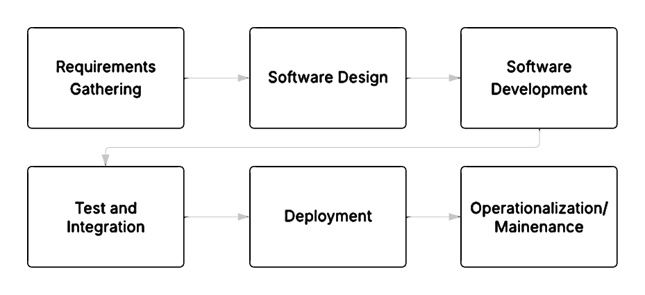
Phases of the software development

Slide 14
Phases of software development: Agile perspective
Requirements Gathering:
Development begins before every detail is completely understood
Requirements and user stories are refined continuously throughout the process

Slide 15
Phases of software development: Agile perspective
Software Design and Development:
The approach is iterative, producing a functional product at the end of each cycle
The agile model follows five stages that repeat
Sprint Planning
Sprint
Daily Scrum
Sprint Review
Sprint Retrospective

Slide 16
Phases of software development: Agile perspective
Deployment:
Deployment and feedback happen continuously throughout the project’s duration rather than as a final phase

Slide 17
SNHU Travel project
Waterfall model
The decision to use a “Top 5 list” instead of a slideshow would have to be required as an early agreement before coding began
Late changes could cause testing delays
Project plans and resource allocation would be finalized before implementation, restricting flexibility
Critical bugs or unmet requirements might delay the final release

Slide 18
SNHU Travel project
Agile model
The slideshow adaption emerged from mid-project feedback and was seamlessly integrated
The project started as soon as a minimal viable product was identified
Tools like Jira and AWS were adopted mid-cycle without disruption
Testing and bug fixes were performed iteratively, reducing risk
User stories and tasks evolve continuously with stakeholders feedback

Slide 19

Assessing readiness: Key decision factors
When deciding between waterfall and agile, consider organizational readiness, culture, and project scope.

Slide 20
Key decision factors
Waterfall Vs. Agile
Waterfall:
Agile:
Requirements are fully defined from the start
Process rely on predictability and minimal change
The organization is not culturally aligned with the Agile principles
Stakeholders can participate actively in reviews and feedback cycles
Leadership supports priority driven work rather than rigid plans
Teams are stable and open to iterative improvement
The organization is prepared to embrace flexibility and evolving requirements

